Slide 1
Reminders
Primary Literature Workshop #3 on Monday
Join a project group by the end of the day Monday
Homework #5 due Tuesday before class

Slide 2
Lecture 14 objectives part 1
Chapter 11 wrap up
Be able to describe how/why cells from within the same tumor may be genetically different from each other
Be able to define and provide examples of how initiators and promoters relate to cancer initiation

Slide 3
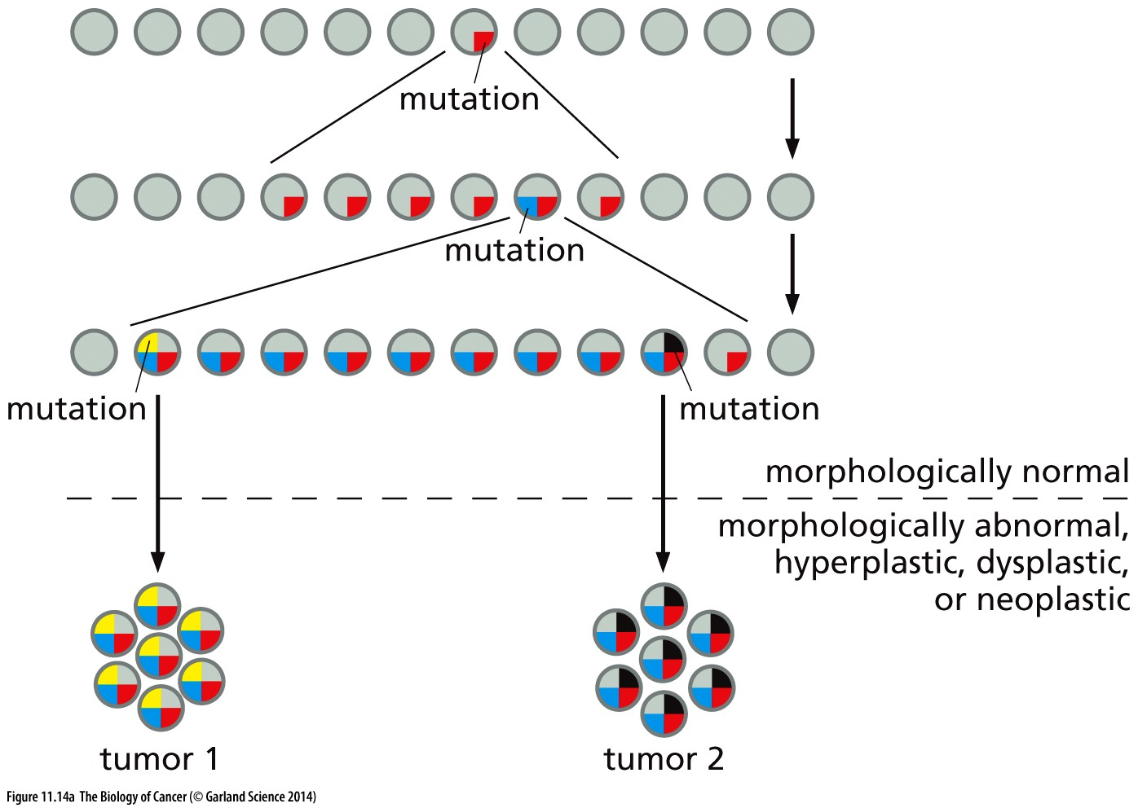
Distinct tumors with a common origin
Mutations in cancer genes are random and infrequent
‘Rate-limiting’ steps mean precancerous cells can persist, poised to become cancerous with an additional mutation(s)
Step #1
Step #2
Step#3
Multiple, seemingly distinct tumors can arise from the same original cell
Is this more likely to happen at an earlier or later step in tumorigenesis?

Slide 4
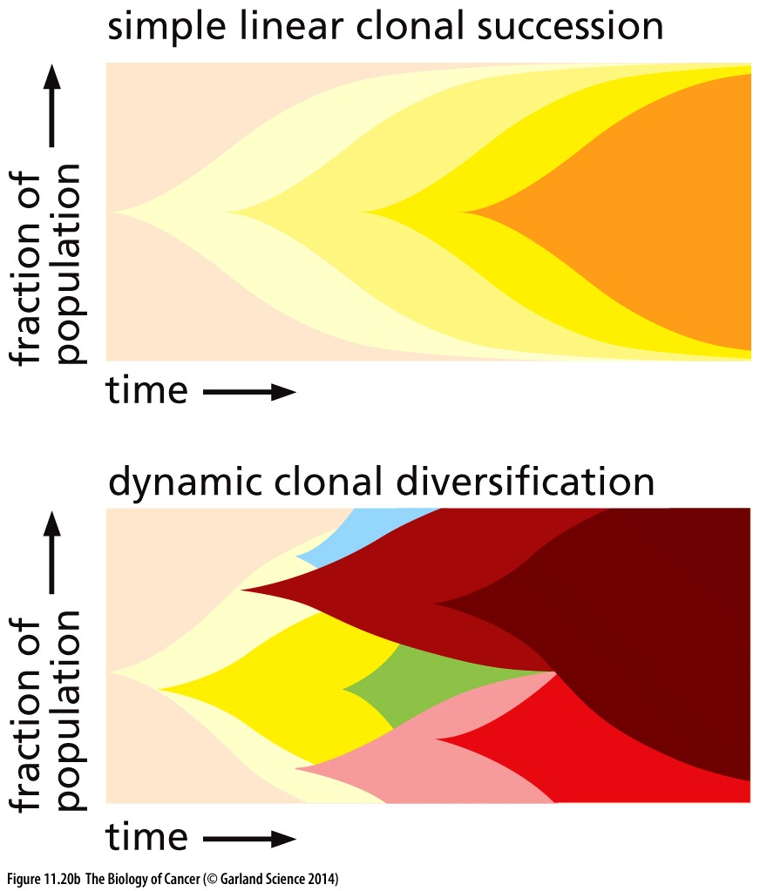
Cancer development is clonal
All cells in a tumor evolve from the same original cell
A linear model would have one cell progressing through each rate-limiting step
The growth advantage this cell gains would allow it to outgrow cells stuck at earlier stages
Tumor would be homogeneous
Not what we see!

Slide 5
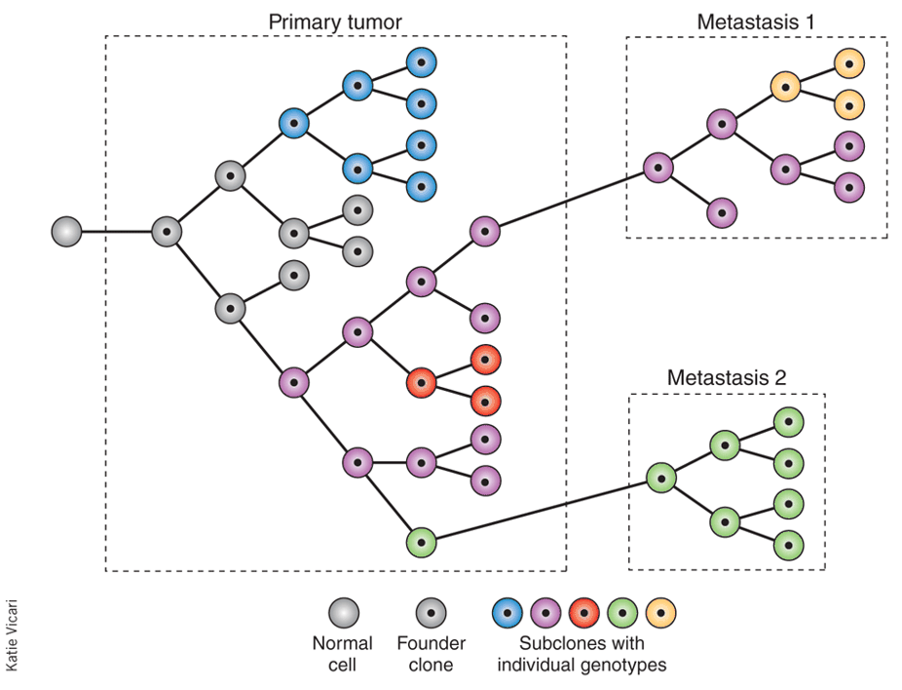
Cancer development is clonal
But NOT linear
Sub-clones can individually evolve/gain new mutations → cells with mutations that increase fitness proliferate more/faster
Consequences:
‘independent’ tumors
tumor heterogeneity

Slide 6
Drivers and Passengers
Acquisition of mutations during tumor development is ongoing
Mutagenesis is random and cancer progresses only in the infrequent event when mutation occurs in a cancer gene that governs a rate limiting step
Other mutations are permitted to accumulate so long as they don’t decrease fitness
Driver mutations promote/are necessary for tumor progression
Passenger mutations are along for the ride

Slide 7
Not all carcinogens are mutagenic
Carcinogens that are mutagenic can provide initiating mutations
Carcinogens that are not mutagenic may simply promote cell proliferation
Cell non-autonomous activation of growth factor signaling
Ie other cells sexcrete GFs or promote infklamation → promotes proliferation of neighboring cells
Induce wounds to promote tissue regeneration
Increased proliferation in the presence of a mutagen can accelerate tumorigenesis

Slide 8
Cancer initiators and promoters
Initiating mutations can lie dormant long periods of time
A cancer promoter can ‘unmask’ the initiating mutation by increasing proliferation → can be non-genetic and transient
What types of internal and external events might serve as promoters of cancer?

Slide 9
Cancer initiators and promoters
Cellular promoters:
Hormones induce cell proliferation: more hormonal cycles → increased risk of breast cancer
Chronic inflammation (colitis, Crohns, gallstones, hep B) → promotes cancers at sites of inflammation
Alcohol kills epithelial cells in the throat, promoting their regeneration → cooperates with smoking to promote head and neck cancer

Slide 10
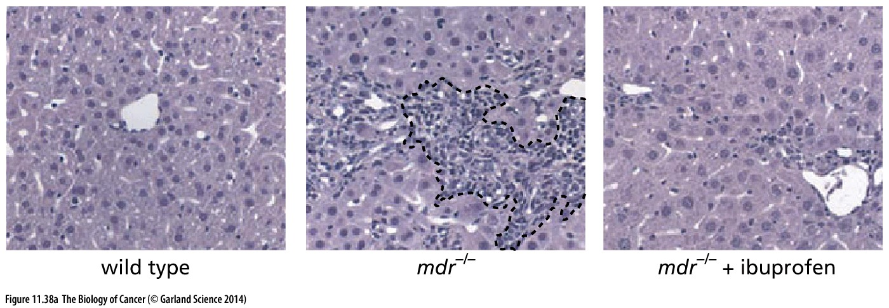
Chronic inflammation and cancer
immune cell → release of TNFa → NF-kB activity → anti –apoptotic genes
chronic inflammation in liver
+ibuprofen
(inhibition of NF-kB)
Lack of apoptosis→ tissue overgrowth that promotes malignancy

Slide 11
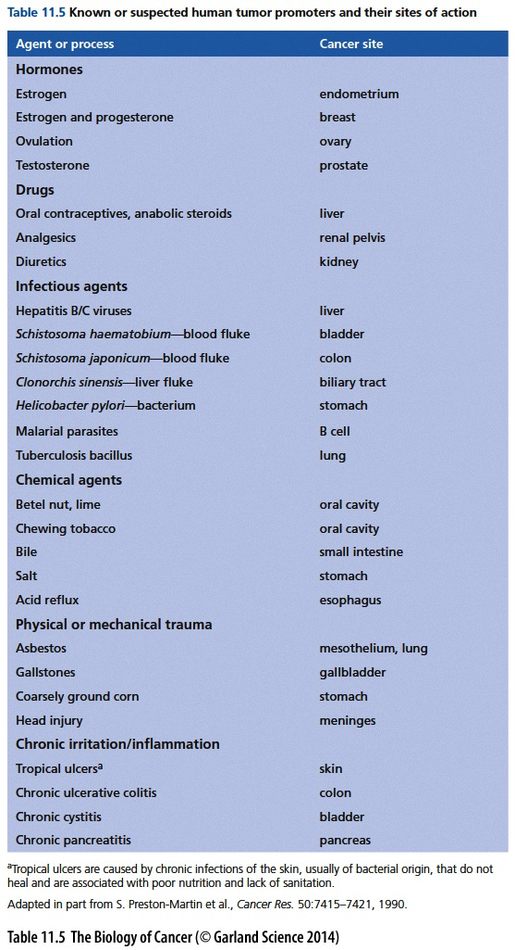
Improbable events become possible
Promoters enhance the rate at which cancers develop
A wide variety of agents that function as promoters have been described
Promote expansion of initiated clones
Necessary to overcome the infrequent event of accumulated mutation in the same cell
more proliferation = more cells with the initial mutations (& more chance to make new mutations)
More cells with initial mutations means > chance for one to randomly acquire additional rate-limiting mutations

Slide 12
Lecture 13 objectives part 2
Chapter 13
Understand and be able to discuss examples of how tumors are made up both cancer cells and normal cells
Be able to provide examples of how normal cells support tumor growth
Understand and be able to discuss strengths and limitations of in vivo and in vitro cancer research models

Slide 13
How does a tumor grow?
Alter intrinsic signaling pathways (mutations in tumor suppressors and oncogenes)
Respond to external assaults and signaling (initiators and promoters)
This is not enough to form a substantial tumor
Cancer cells recruit normal cells and co-opt them for the benefit of the tumor

Slide 14
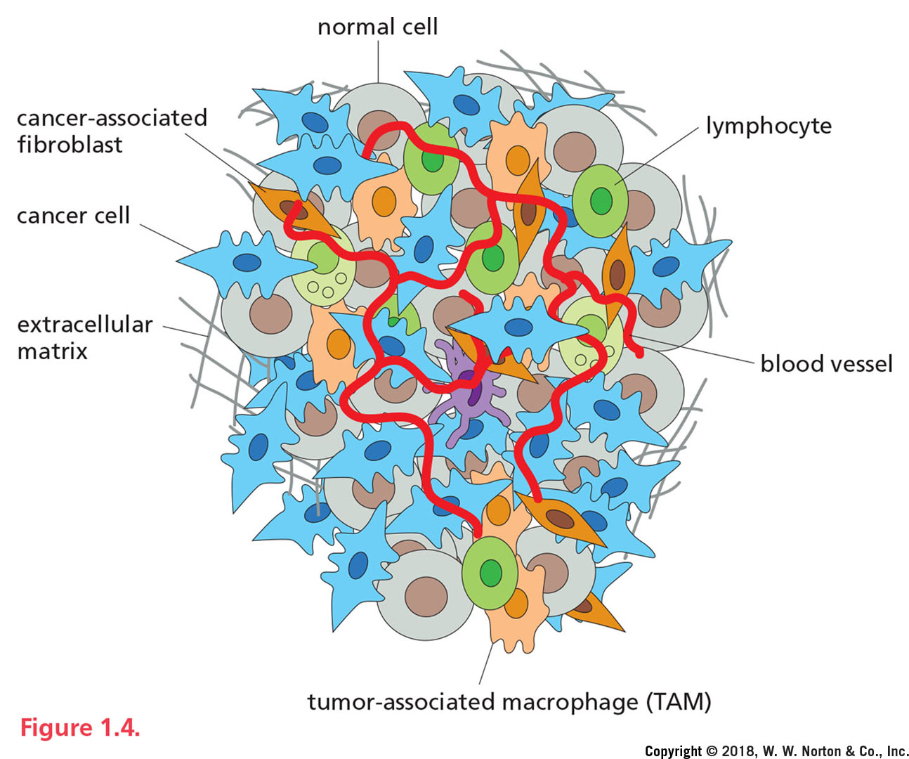
Tumors interact with their environment
The tumor microenvironment:
is made of more than just cancer cells
Poses challenges to the tumor that must be overcome
Represents non-cancer cell targets of cancer therapeutics

Slide 15
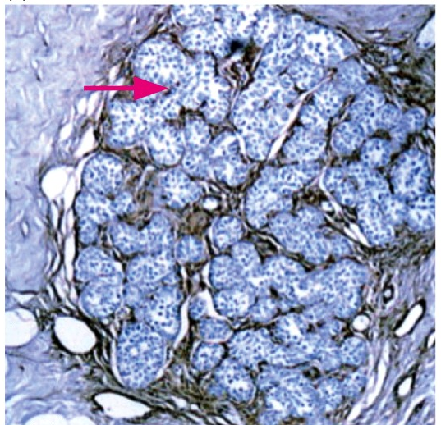
Tumor microenvironment
Tumors are made up of a number of distinct cell types and have complex microscopic structures
Non-cancer cells may account for very little or > 90% of cells within the tumor mass depending on cancer type
How do they get there?
What do they do? Why are they there?
How can we exploit them to kill cancers?
Breast carcinoma: cancer cells and stromal fibroblasts coexist in the tumor

Slide 16
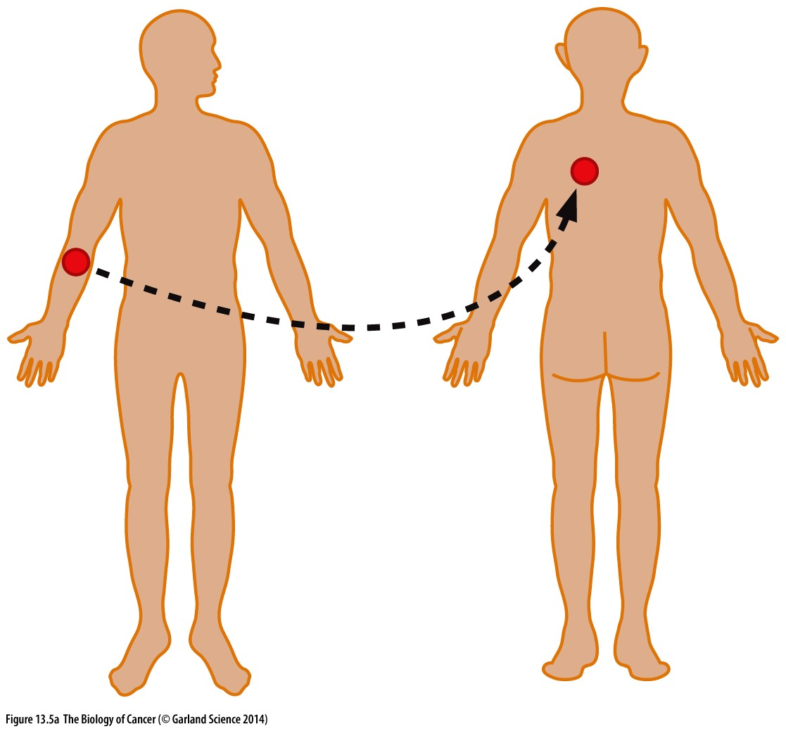
Not just contamination
How do we know stromal cells are actively recruited or maintained and not just a remnant of the normal tissue?
graft of only carcinoma cells →transplant failed to grow
Graft of carcinoma + tumor-associated stroma → transplant is well established
Stromal cells collaborate with cancer cells to form and maintain a tumor

Slide 17
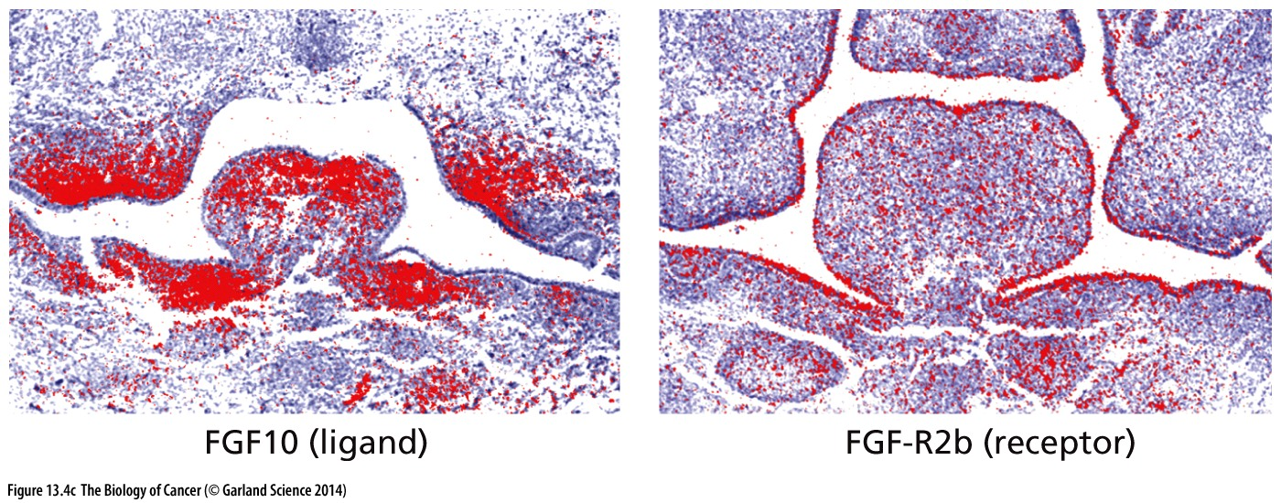
Communication and collaboration
Tissue architecture is formed and maintained by way of cell-to-cell communication
Cells communicate with endocrine and paracrine signaling
Endocrine signaling: long distances via circulation
Paracrine signaling: short distances between nearby cells
Cells that respond must have the appropriate receptors

